Slide 1
BANKING SYSTEM IMPLEMENTATION
This presentation covers a scalable banking system design using inheritance.
We focus on flexibility, reusability, and maintainability through object-oriented principles.
By Team ➔ Code Cadets
Members
Himanshu (24SCSE1410339)
Pratham Singh Mehta (24SCSE1410349)
Annu Gautam (24SCSE1410353)
Vaibhav (24SCSE1410298)

Slide 2
System Overview: Core Classes
Banking System Class
Account
Contains the “Main "method to demonstrate the functionality of the banking system, including depositing, withdrawing, and calculating interest.
This is an abstract base class that defines the common properties and methods for all account types.

Slide 3
ACCOUNT
Savings Account
Savings
Account
Inherits from “Account” and implements specific behavior for savings accounts, including a higher interest rate and a lower withdrawal limit.
Current Account
Current
Account
Also inherits from “Account”
but has a different interest rate
and a higher withdrawal limit.

Slide 4

Account Class:
Base Functionality
Attributes
Methods
account number (String), balance (double)
deposit(), withdraw(), getBalance()
Sample
Account account1 = new Account("12345", 1000.00);

Slide 5
Savings Account: Earning Interest
Inheritance
Methods
Extends Account,
adds interestRate attribute
calculateInterest(), applyInterest()
Feature
Example
Interest rates tiered by balance amount
SavingsAccount savings1 = new SavingsAccount("67890", 500.00, 0.02);

Slide 6




Current Account: Overdraft Protection
Extension
Inherits Account, adds overdraftLimit attribute
Withdrawal
Allows withdrawals beyond balance up to overdraft limit
Customer Action
Can apply to increase overdraft limit
Example
CurrentAccount current1 = new CurrentAccount("13579", 2000.00, 500.00);

Slide 7



Inheritance Benefits: Code Reusability
Efficiency
Maintainability
Share common attributes and behaviors in base Account class
Updates to Account reflect in all subclasses instantly
Extensibility
Easily add new account types without rewriting code

Slide 8
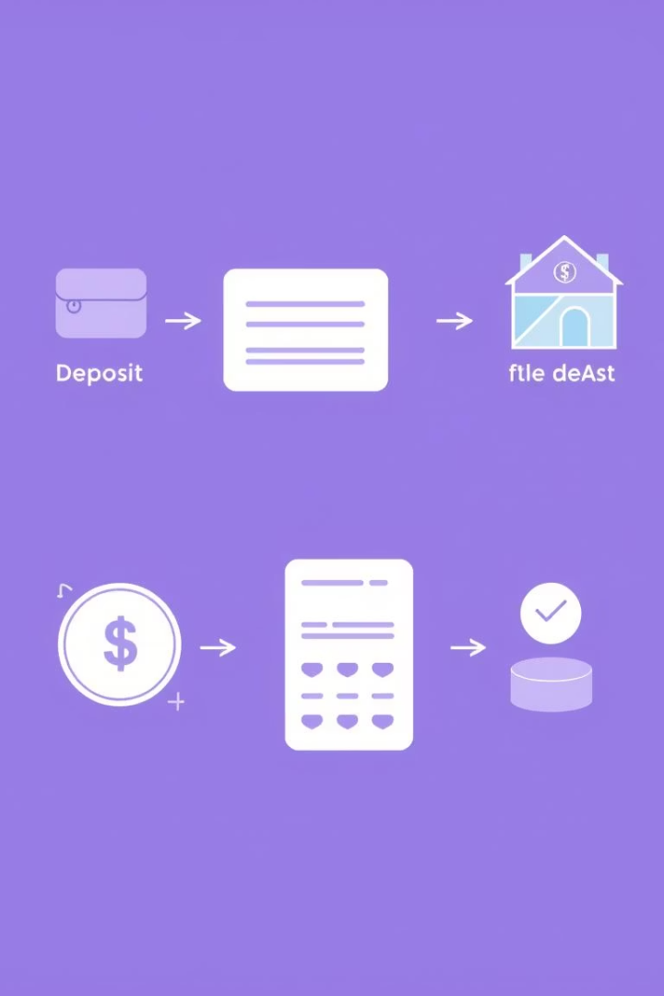
Example Scenario: Transactions
Step 1: Deposit
Customer deposits 500 into SavingsAccount
Step 2: Interest
Calculate and apply interest to savings balance
Step 3: Withdrawal
Customer withdraws 2500 from CurrentAccount using overdraft
Step 4: Update
Balances update and display after transactions

Slide 9

Conclusion: Scalable Banking Solution
Structure
Uses inheritance for efficient, clear design
Flexibility
Supports diverse customer account needs
Maintainability
Simple updates improve all account types

